Slide 1
PENERAPAN ALGORITMA GENETIKA DAN ALGORITMA GENETIKA HYBRID DALAM PENYELESAIAN PUZZLE SUDOKU
Samuel Lukas
Arnold Aribowo
Junaidi
Informatics Department, UPH, Lippo Karawaci, Indonesia

Slide 2
Topics of discussion
Introduction
Problem Definition
Heuristics Search Algorithm
Hybrid Genetic Algorithm
Experiment Result
Conclusion

Slide 3
Thank You

Slide 4
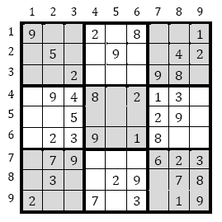
Introduction
Puzzle Sudoku is one of a logic numbers puzzle
It is classified as a logic grid.
It as three basic elements namely, rows, Columns and streams
Next

Slide 5
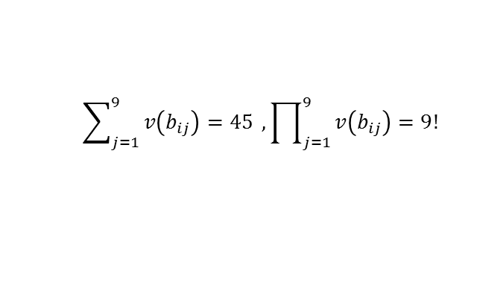
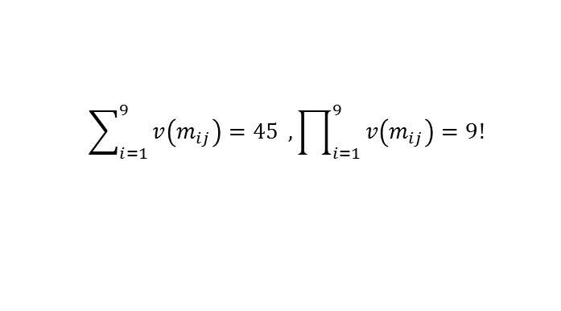
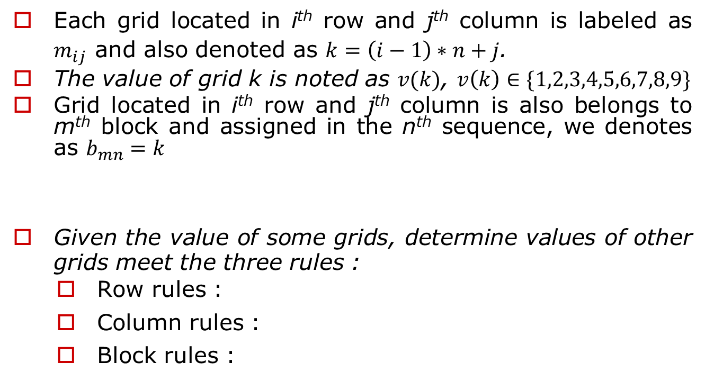
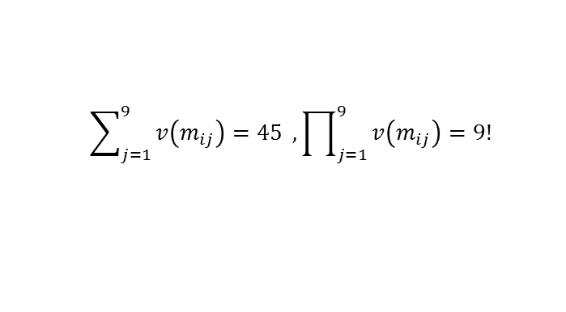
Problem Definitions
Each grid located in i^{th} row and j^{th} column is labeled as $m_{ij}$ and also denoted as $k=\left(i−1\right)∗n+j$.
The value of grid k is noted as $v(k)$, $v\left(k\right)∈\{1,2,3,4,5,6,7,8,9\}$
Grid located in i^{th} row and j^{th} column is also belongs to m^{th} block and assigned in the n^{th} sequence, we denotes as $b_{mn}=k$
Given the value of some grids, determine values of other grids meet the three rules :
Row rules :
Column rules :
Block rules :
$$m=f\left(i,j\right)=3\left(div\left(i−1\right),3\right)+div\left(\left(j−1\right),3\right)+1$$
$$n=g(i,j)=3\left(mod\left(i−1\right),3\right)+mod\left(\left(j−1\right),3\right)+1$$
$$\sum_{j=1}^{9}{v\left(m_{ij}\right)=45} , \prod_{j=1}^{9}{v\left(m_{ij}\right)=9!}$$
$$\sum_{i=1}^{9}{v\left(m_{ij}\right)=45} , \prod_{i=1}^{9}{v\left(m_{ij}\right)=9!}$$
$$\sum_{j=1}^{9}{v\left(b_{ij}\right)=45} , \prod_{j=1}^{9}{v\left(b_{ij}\right)=9!}$$
Next

Slide 6
Heuristic Search Algorithm
Generate all possible value to the blank k^{th} grid,
Using Three rules of Sudoku :
If last value then goto 1
If hidden_single then goto 1
If naked_pair then goto 1
Next

Slide 7

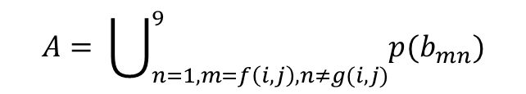
Heuristics Rules
Last Value in row, column and block
Hidden single in row, column and block
$p^{′}\left(m_{ij}\right)=p\left(m_{ij}\right)−A$, $A= \bigcup_{y=1, y≠j}^{9}{p(m_{iy})}$, $A= \bigcup_{x=1, x≠i}^{9}{p(m_{xj})}$
Naked pair
$$A= \bigcup_{n=1, m=f\left(i,j\right), n≠g(i,j)}^{9}{p(b_{mn})}$$
Next

Slide 8
Hybrid Genetic Algorithm
Chromosome Design
Generate First Generation
While notsolve do
N-Segment Crossover
Displacement mutation
Heuristics search algorithms
Fitness
if fitness = 1 then solve
Display Result
Next

Slide 9
Chromosome Design
A chromosome, labeled as string C, is segmented into 9 segments. It represents 9 blocks.
In each segment contains genes, the number of the empty grids in that block.
The segment is ordered according to least empty grid of the block.
The gene sequence in a segment is determined randomly within all possible genes in that segment.
From problem above then one of the chromosome could be :
“79 70 8 27 7 16 46 38 28 37 36 54 45 53 32 42 50 41 40 64 75 74 66 55 60 59 77 67 58 19 3 10 20 2 12 24 5 15 22 13 23”.
Next

Slide 10
First Generation
For n = 1 to z (number of population)
Generate one chromosom randomly and set value of each gen by
For i = 1 to n (number of gen in chromosome)
if heuristics search then w(i)=1 else w(i)=0
Endfor
Endfor
Next

Slide 11
N-Segment Crossover
Parent 1 : 7970 | 270908 | 4546|
Parent 2 : 7079 | 092708 | 4645|
Child 1 : 7079 | 270908 | 4645|
Child 2 : 7970 | 092708 | 4546|
Next

Slide 12
Displacement Mutation
Old Chromosome
7970 | 270908 | 4546|
New Chromosome
7970 | 080927 | 4546|
Next

Slide 13
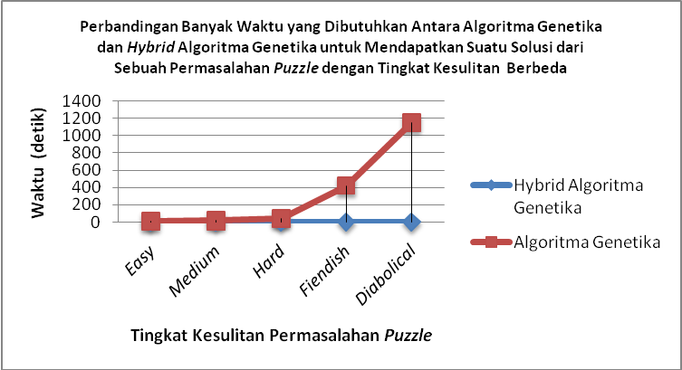
Experiment Result
Next

